Slide 1
Today’s Agenda:
Safe Array
Dynamic Safe Arrays.
Jagged Array

Slide 2
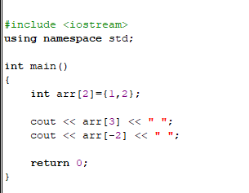

Slide 3
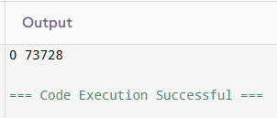

Slide 4
Safe Array
This is a type of the array that ensures to handle the error of index out of bounds. This is done by overloading the subscript [ ] operator.

Slide 5
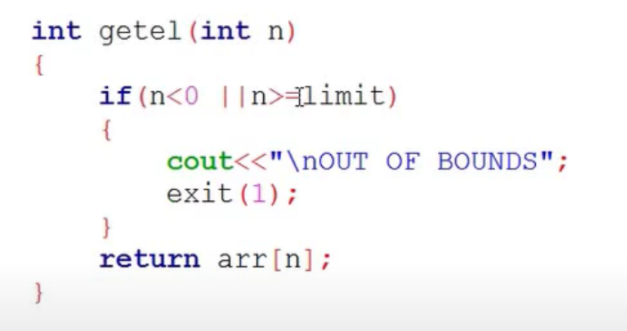
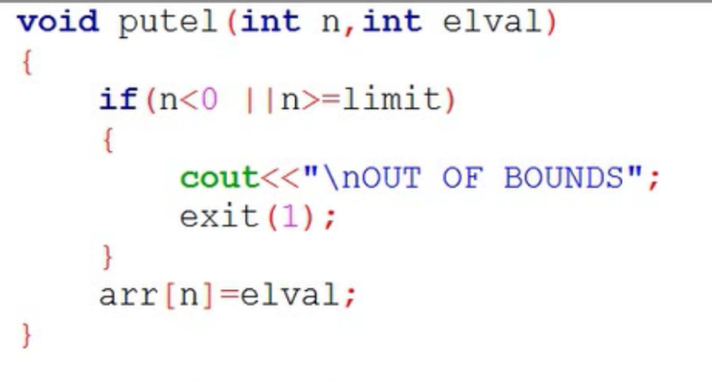
First approach to implement SA

Slide 6
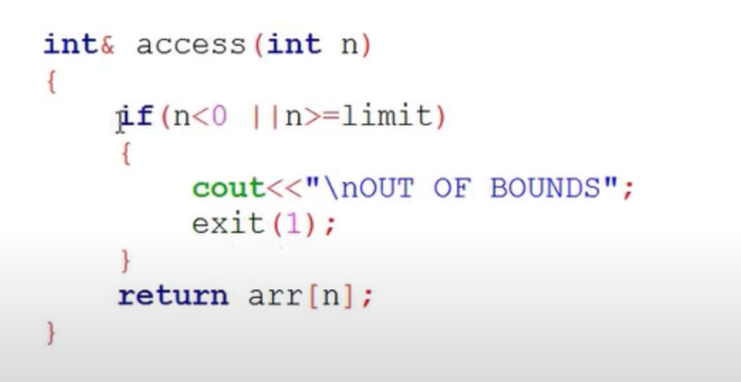
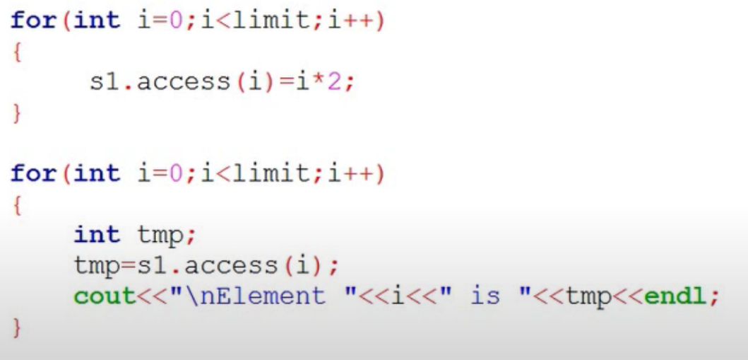
Second approach to implement SA

Slide 7
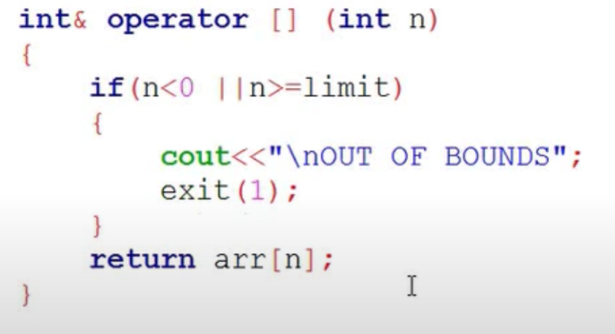
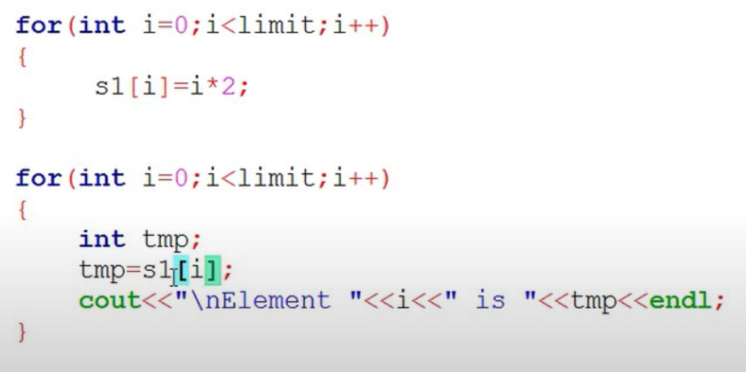
Third approach to implement SA

Slide 8
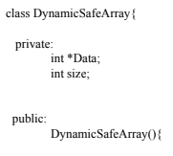
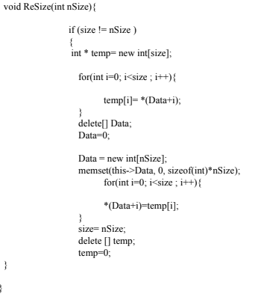
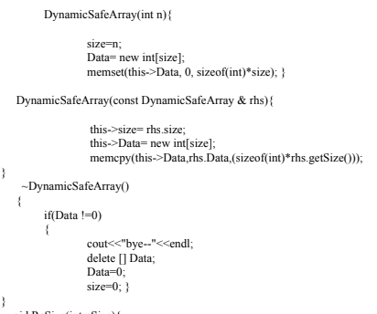
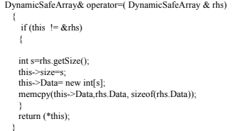
Dynamic Safe arrays.

Slide 9
Jagged Array
This is also referred to as an Array of pointers or Array of arrays. This is a multidimensional with different sizes.

Slide 10
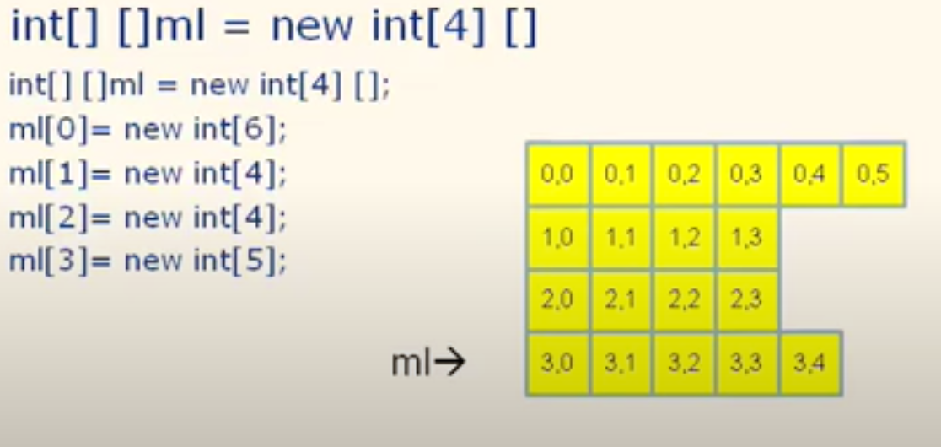

Slide 11
